Slide 1
Lecture 11
COMP207

Slide 2
Overview
Go over weekly assessment
Go over weekly survey
How to deal with deadlocks
Timestamp based approaches to schedules

Slide 3
Weekly survey
Positive:
  Discussion Board extremely helpful with quick and detailed responses.
  Nice to see feedback about it being hard to read what is being typed/output taken seriously and improved - thank you!
  From a few lectures ago, but going through an example exam question helped greatly with the assignment and understanding how to handle questions.
Response: That is nice to hear! I am glad that people use the discussion board.

Slide 4
Weekly survey part 2
Negative:
  Not necessarily something that didn't work well, but maybe adding more going through exam questions where applicable? Would be especially useful, personally, regarding locks as I still understand them less than other aspects of the course. (I understand if we have to move on in the course and cannot do this, still believe it would be beneficial to add more example exam questions for later topics)
Response: I will try to do that more in the future. I won’t have time today though, I believe, because this timestamp based schedules/deadlock detection is quite large

Slide 5
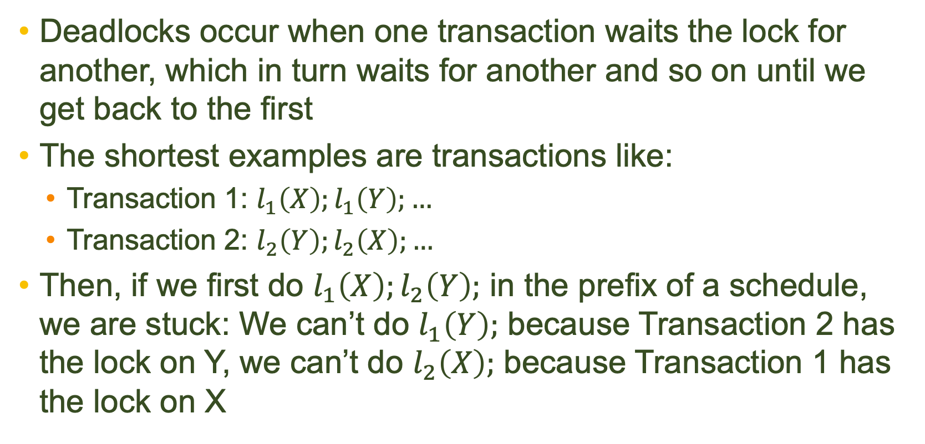
Deadlocks
Deadlocks occur when one transaction waits the lock for another, which in turn waits for another and so on until we get back to the first
The shortest examples are transactions like:
  Transaction 1: $l_{1}\left(X\right);l_{1}\left(Y\right);…$
  Transaction 2: $l_{2}\left(Y\right);l_{2}\left(X\right);…$
Then, if we first do $l_{1}\left(X\right);l_{2}\left(Y\right);$ in the prefix of a schedule, we are stuck: We can’t do $l_{1}\left(Y\right);$ because Transaction 2 has the lock on Y, we can’t do $l_{2}\left(X\right);$ because Transaction 1 has the lock on X

Slide 6
Are we deadlocked?
The simplest way that typically works is to just wait: If a transaction waits for a lock for long, it is likely deadlocked
  This is used in many DBMS. The version of MySQL used in the University computers does it by default
Wait for graphs: Draw a graph of who waits for whom. A deadlock is then a cycle in that graph
  Newer versions of MySQL does this, except if there is above 200 in a cycle, it skips it and just rollback the transaction asking for this. Also the case if there are more than 1000000 locks.

Slide 7
Timestamp based approaches
In common for the variants, we see:
  You are older than someone else if you start first
    =You get a timestamp based on start time
  The young ones might die
    Die=rollback and start over (no new timestamp)
There are two variants:
  Wait-die: You die if an older transaction has a lock you want
  Wound-wait: You die if an older transaction wants a lock you have
It is trivial to see that we can’t have a deadlock: A deadlock is a cycle in the wait-for graph and there must be at least one place where an older transaction waits for a younger one and a younger transaction waits for an older

Slide 8
Timestamp-based approaches to scheduling
We also saw a different way of dealing with problems than locks: timestamp-based approaches
Intuitively, we want each transaction to do everything in the order they started in
  If something messes with that view, we restart some transactions
  As opposed to timestamps for deadlock detection, restarting DOES give you a new timestamp!

Slide 9
What? A mess?
We have two variants:
  Basic
  MVCC
Basic: We give each item a read-timestamp and a write time-stamp for when they were last read/written to
  If you try to write and the read or write timestamp is later than your timestamp, you restart (otherwise things are fine)
  If you try to read and the write timestamp is later than your timestamp, you restart (otherwise things are fine)

Slide 10
MVCC
In MVCC, we have many versions of each variable, one for each time it was written to
  Each has a read time as well!
If you try to read in MVCC, you get the version with the largest timestamp smaller than yours
If you try to write, you check if the version with the the largest timestamp smaller than yours had a bigger read time than your own timestamp, if so, you restart otherwise, you write a new version of the variable

Slide 11
Strict versions
We can also do strict, by only allowing you to read/write to variables after other transactions that access them have committed

Slide 12

Happy Halloween!
"image: Freepik.com". This slide has been designed using assets from Freepik.com

